Slide 1
K-Means in
Clustering Flights Delays
Group 6:
JL, LQ,
ZW, JW

Slide 2
Data & Tasks
Data: 2 million records, each with 13 attributes,
collected from U.S. Department of Transportation
Task 1:
the distributed K-means clustering algorithm that uses multiple tasks for each iteration
Task 2:
the local K-means algorithm that computes an entire clustering for a single K in a single task.

Slide 3
Task 1: Workflow
Data (DataFrame)
point
pair RDD
pair RDD
function: nearestCenter(point, center)
Cluster id | point
0
1
0
0
Cluster id | center
0
1
ReduceByKey
Broadcast Center (DataFrame)
Convert to DataFrame

Slide 4
Task 1: Challenges
Problem: When we try to change the variable inside foreach loop, this change will not be applied after we end the loop
(in re-assignment part)
Solution: Use map to calculate new cluster id

Slide 5
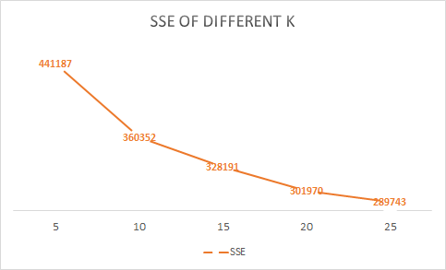
Task 1: the best k
1 million data
with 5 machines

Slide 6
Task 1
Speedup:
Scaleup:
Number of workers(1 million) | Running time | Number of workers(2 million) | Running time
5 | 303s | 5 | 960s
10 | 194s | 10 | 384s
Input size | Running time change
100,000 | + 37s (97s)
1,000,000 | + 206s (303s)
2,000,000 | + 657s (960s)

Slide 7
Data & Tasks
Data: 2 million records, each with 13 attributes,
collected from U.S. Department of Transportation
Task 1:
the distributed K-means clustering algorithm that uses multiple tasks for each iteration
Task 2:
the local K-means algorithm that computes an entire clustering for a single K in a single task.
Notes:
Have a outline slides again, so we can introduce the 2nd task

Slide 8
Task 2: Input
Two Input
Pre-processed flight data
File with various k and their randomly selected initial centers. (format: num_of_k@center_1~center_2~...)
Example:
2@0.9397260273972603,0.16666666666666666,0.8542538354253835,0.9067501739735561,0.8895066018068102,0.946490618485059,0.0743801652892562,0.08454106280193237,0.03765690376569038,0.07432432432432433,0.047018115204559334,0.047619047619047616,0.07027027027027027~0.021917808219178082,0.33333333333333337,0.6311018131101812,0.7362560890744607,0.6532314107018763,0.7505211952744961,0.2975206611570248,0.05475040257648953,0.02092050209205021,0.2922297297297297,0.24689599023000205,0.07142857142857142,0.03513513513513514

Slide 9
Task 2: Workflow
Broadcast Flight Data (DataFrame)
pair RDD
point
num_of_k | Calculated new centers (list of list of doubles)
5
8
10
12
function: localKmeans (center, data)
Output: same format as input
Distributed Center:
(pair RDD)
Iteration until converge
Notes:
Need to explain: Iteration until coverage

Slide 10
Task 2: Challenges
Change the partition size of the algorithm.
Increase the heap size, so aws could handle larger amount of input data.
1g (default) -> up to 250,000 rows
3g -> 1,000,000 rows
Increase executors’ memory as the broadcast variable becomes larger.

Slide 11
Task 2
Speedup:
Default Partition Size: 2 when input is 100,000
We increase the partition size to 10 and 26.
Input size | Partition Size | Running time change
1,000,000, k = 2- 27 | 10 (5 machine) | 1 hour 21 min
1,000,000, k = 2- 27 | 20 (5 machine) | 57min (24 min less)
1,000,000, k = 2- 27 | 20 (10 machine) | 57min (same with 5 machines)
1,000,000, k = 2- 27 | 26 (7 machine) | 45min (36min less)
Notes:
Custom Partitioner

Slide 12
Task 2
Scaleup:
With 27 different k value
5 Machine with 20 partition
Input size | Memory Size | Running time change
100,000 | Default (1g driver memory) | 5min (cluster < 23, as when k > 23 there are null clusters appear)
500,000 | 3g driver memory | 26min
1,000,000 | 3g driver memory | 57min
2,000,000 | 6g driver memory 3/6g executor memory | Have out of memory exception with regular m5.xlarge machines
Notes:
20 Partitions are the best possible partition for 5 m5.xlarge machines
broadcast the small RDD to all worker nodes. it also needs to fit completely into the memory of each executor.It also needs to fit into the memory of the Driver!
Broadcast variables are shared among executors using the Torrent protocol i.e.Peer-to-Peer protocol and the advantage of the Torrent protocol is that peers share blocks of a file among each other not relying on a central entity holding all the blocks.

Slide 13
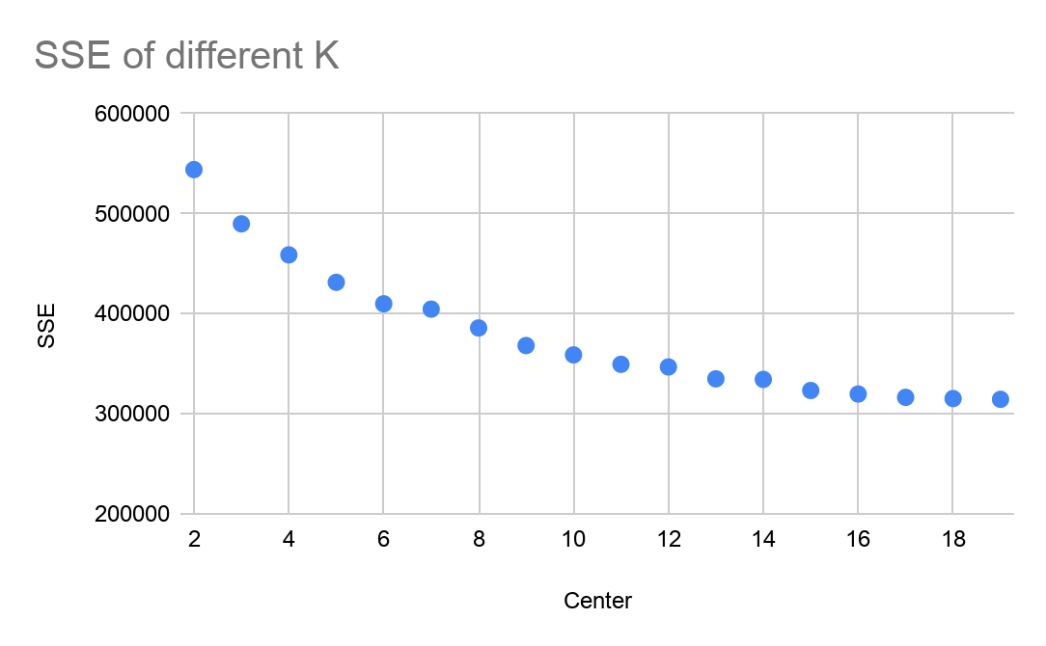
Task 2: Elbow Method Finding Best K
1 Million row of data
Experimented k range from 2 to 27
The elbow is found around k = 12 ~ 15
Only need one run
Elbow

Slide 14
Conclusion
Both programs show good speedup and scaleup
Local Kmeans is good at running multiple results within one run. Easier and faster for finding the most suitable k value.
Distributed Kmeans is better at handling more data for one run than local Kmeans.
Notes:
Limit by the natural of the broadcast: as we know the broadcast is best fit for join a large table with a small table.

